Slide 1

Descriptive Analytics with Python
Sridhar Palle, Ph.D.

Slide 2
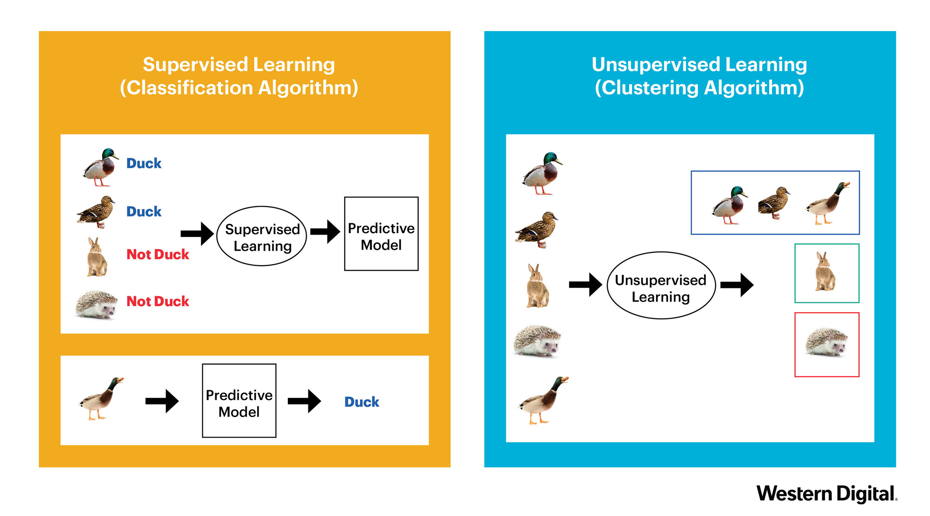
Supervised vs Unsupervised
Labelled Data
No Labelled Data

Slide 3

Unsupervised Learning Techniques
Association Rules Mining (ARM)
Co-occurrences of items/item sets
Objective is not to predict occurrence of item, but to find usable, hidden patterns
Clustering
Automatically segregate dataset into groups
Ex: automatically classify news articles

Slide 4
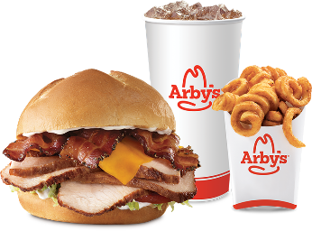

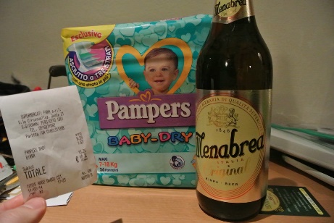
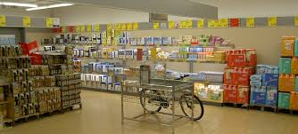
ARM
Obvious Ones:
Not so obvious
Prized discoveries
Business can profit from
Advantages
Bundle Pricing
Product placement
Shelf space optimization
Downside
May also lead to spurious relationships when dealing with data with billions of transactions

Slide 5
ARM Procedure
Step 1: Prepare data in a particular format
Step 2: Short-list frequently occurring items (or items sets), based on some support level
Step 3: Generate relevant association rules from item sets generated in step 2 (based on some confidence parameters)
{Item A} -> {Item B}
Item A – Antecedent or premise of a rule
Item B – Consequent or conclusion of a rule.
Main challenge for association rule analysis are
Computational time and resources
Ex: For association analysis of ‘n’ items, there will be
2^{n} -1 item sets, and 3^{n} – 2^{n} + 1 association rules can be found
Fortunately there are algorithmic approaches to efficiently find the frequent item sets and rules based on some parameters (support, confidence, lift)

Slide 6
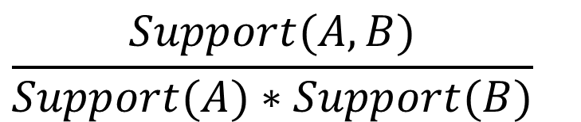
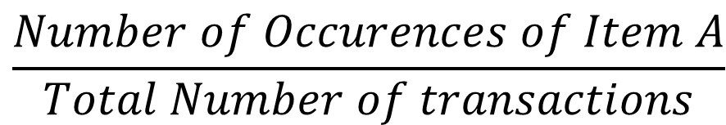
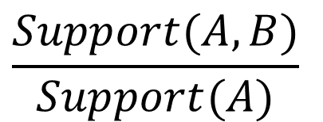
Support, Confidence, Lift
$$\frac{Number of Occurences of Item A}{Total Number of transactions}$$
Support (A) =
Confidence (A → B) =
Lift (A → B) =
$$\frac{Support(A,B)}{Support(A)}$$
$$\frac{Support(A,B)}{Support(A)∗Support(B)}$$

Slide 7
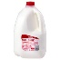





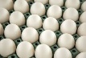
ARM Practical Example: Grocery Store
Step 1: Prepare data in a particular format
Step 2: Short-list frequently occurring items/item sets based on some support level
Step 3: Generate Rules

Slide 8
ARM: Grocery store
Rule Significance

Slide 9
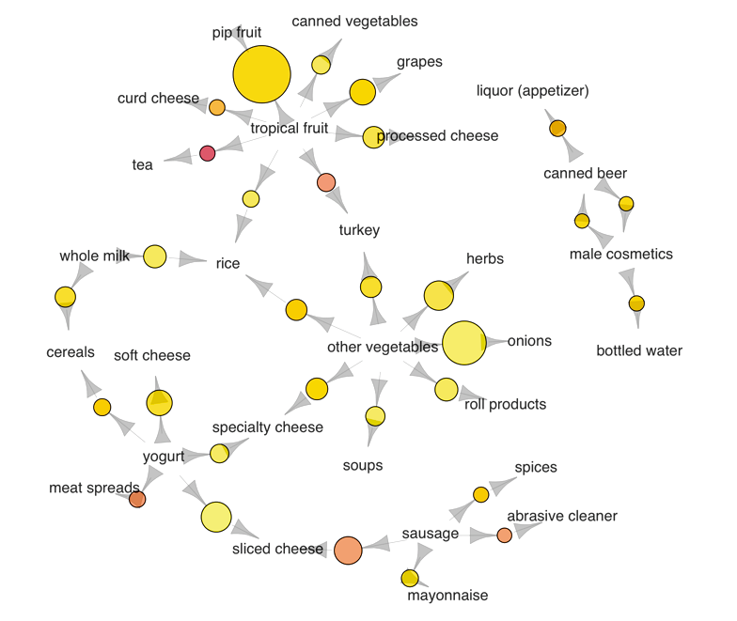
ARM Network Graph
Source: kdnuggets

Slide 10
Clustering
Automatically sorting data in groups of clusters
Raw Data
Algorithm

Slide 11
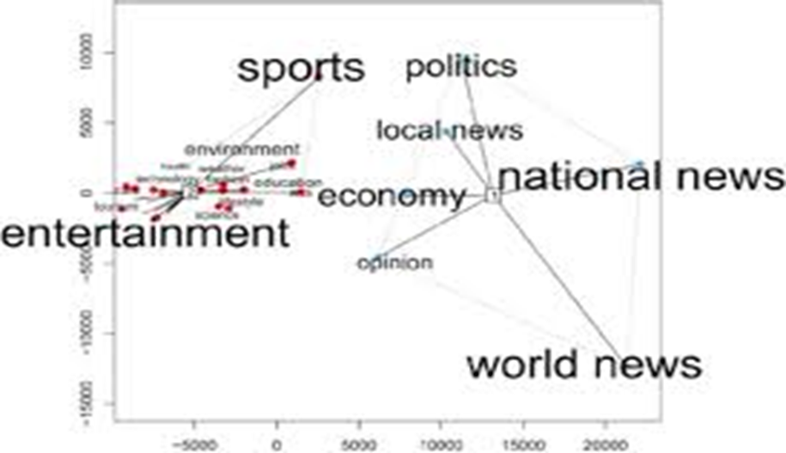
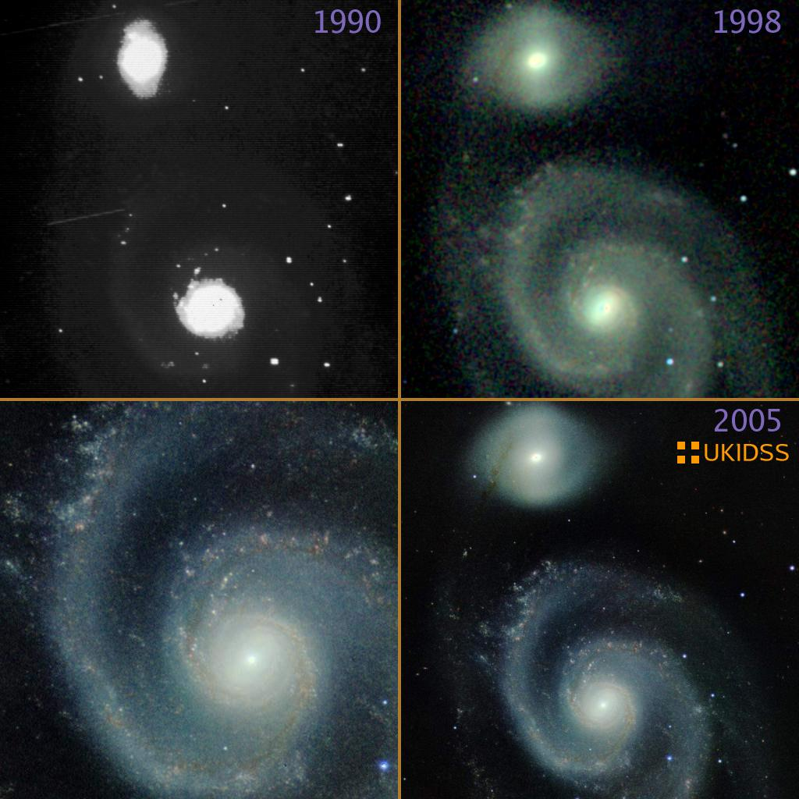
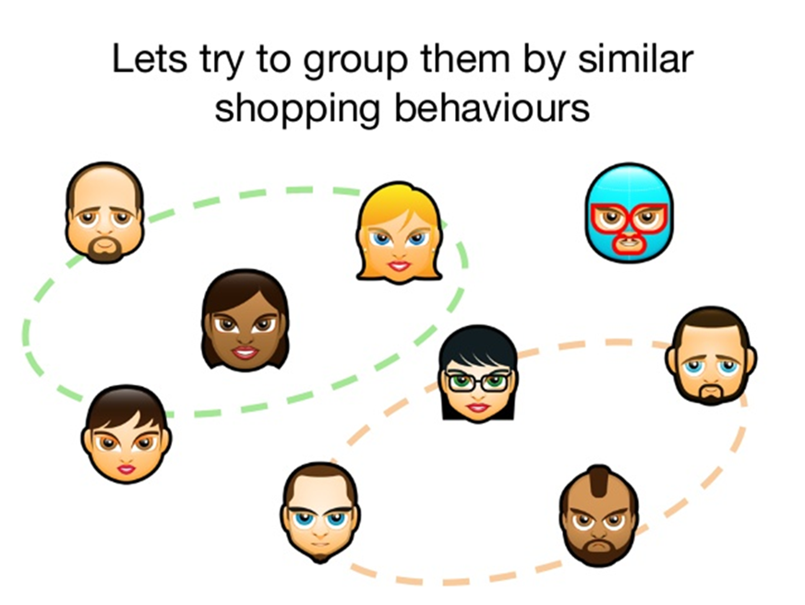
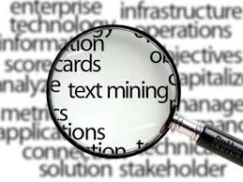
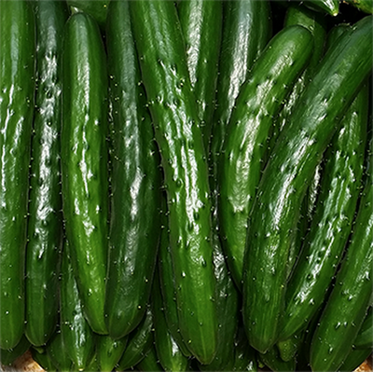

Clustering
Clustering is the process of automatically segregating dataset into different groups based on commonalities (similarities).
Applications in diverse domains
Different clustering algorithms exist
Kmeans
Kmedoids
Hirerchical clustering
DBSCAN

Slide 12
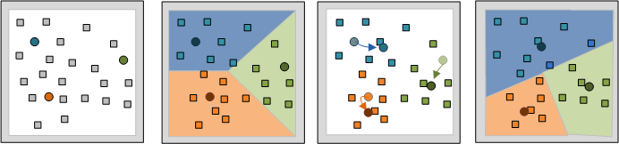
K-Means Algorithm

Slide 13
Descriptive Analytics with Python
Please go to the link below
Tinyurl.com/ece-bdata-python/
Download the folder
DA-Python
Open Jupyter notebooks related to ARM and Clustering using Anaconda

Slide 14
Thank You ☺
Any questions?

Slide 15
